Slide 1
CFD Simulation for Bridge pier Scour Case III Distance between bed level and foundation top=30mm
By Isha Nagpurkar
Date: 27/03/2020

Slide 2
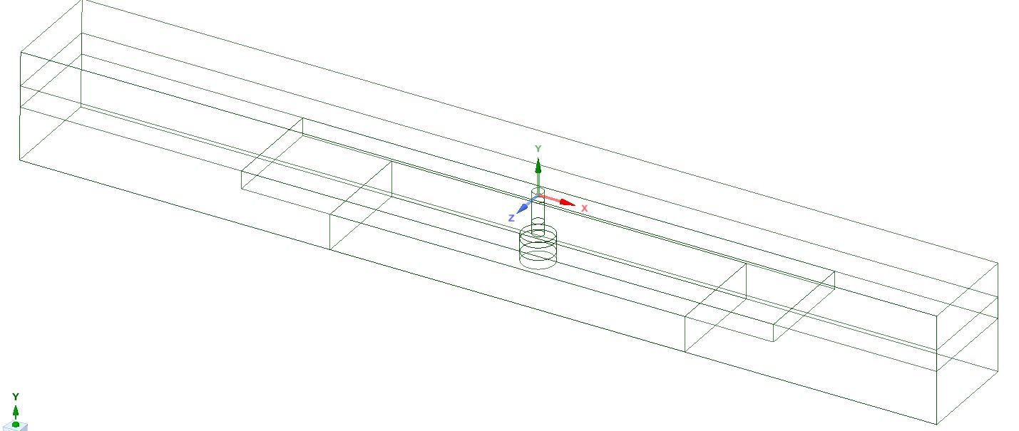
Geometry overview Actual model
Pillar
Outlet
Foundation
Inlet

Slide 3
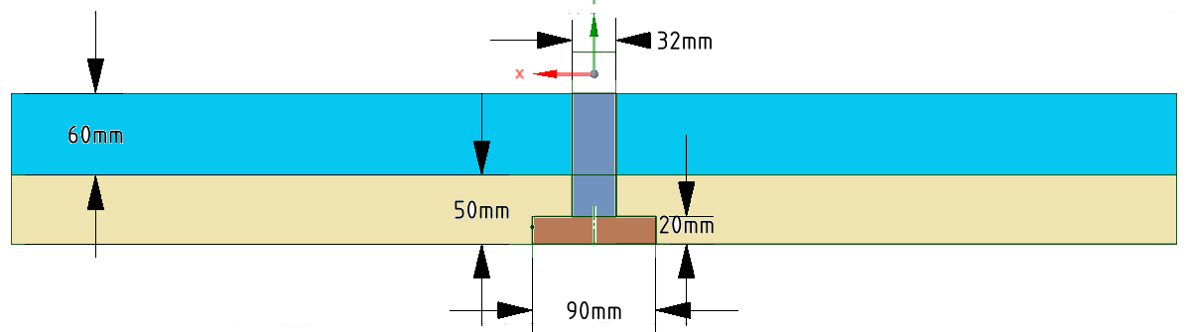
Dimensions
water
pillar
sand
Foundation

Slide 4
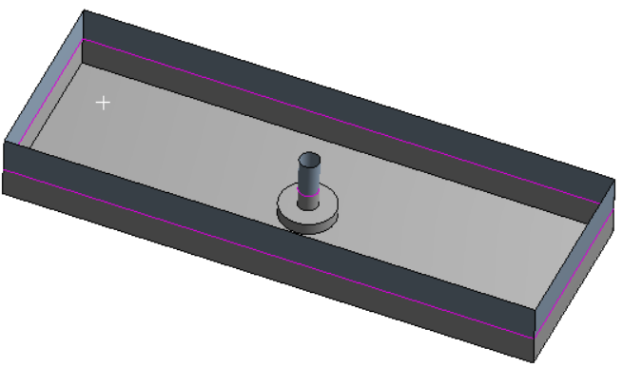
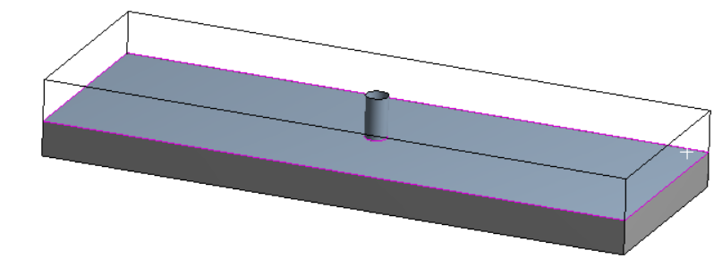
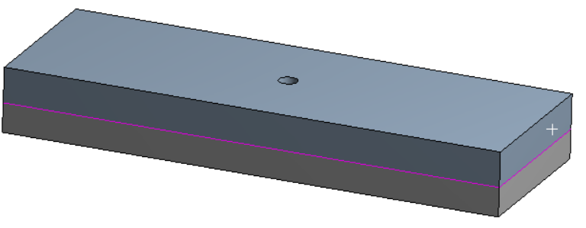
Fluid Domains
Sand
Water

Slide 5
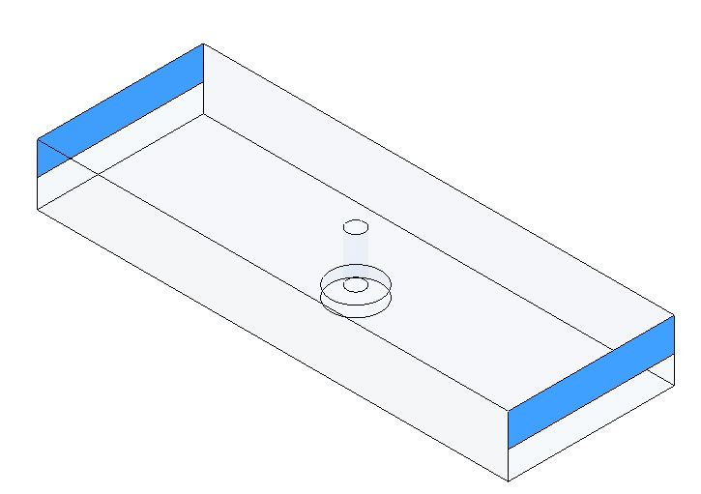
CFD Domain
Outlet
Wall
Inlet

Slide 6
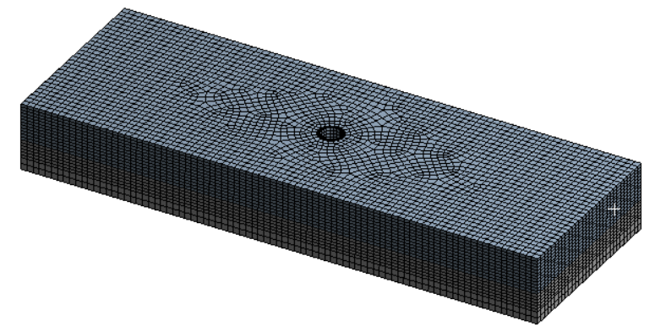
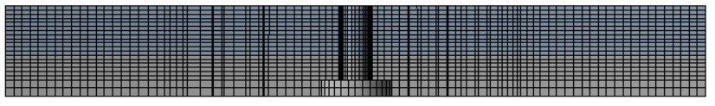
Mesh
Iso View
front View

Slide 7
Mesh statistics and boundary conditions
Nodes | Elements | Tetrahedra | Pyramids | Hexahedra
58557 | 53240 | 0 | 0 | 53240
Minimum face angle (deg) | Maximum face angle (deg)
57.4682 | 25.806
Boundaries
Boundary-Inlet
Type | Velocity Inlet | 0.42 m/s
Boundary- Outlet
Type | Outflow
Boundary- wall
Type | Smooth wall

Slide 8
Material properties
Properties
Sand | Density | 2760 | Kg/m3
 | Particle size | 15 | mm
Water | Density | 998 | Kg/m3
Time | Time step | 0.0001 | sec
 | No of time steps | 50000
 | Total time | 1.25 | sec
 | Actual simulation time | 8 t0 9 | hours

Slide 9
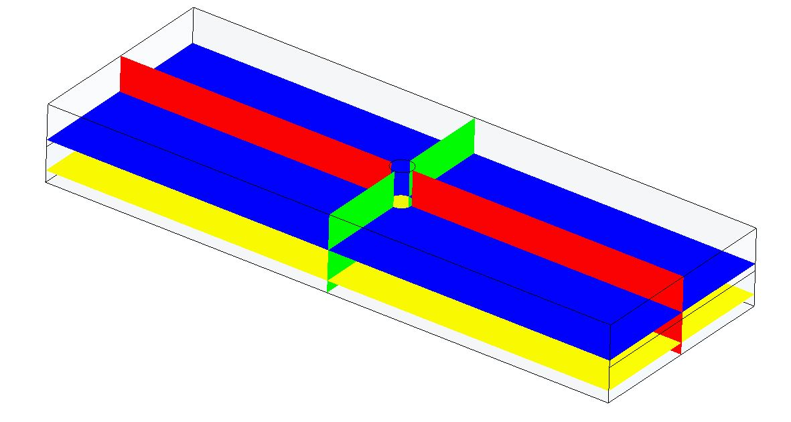
Position of Planes for plots
Plane 4
All the plots of the result at the end of total time of 1.224 sec.
Plane 1
Plane 2
Plane 3

Slide 10
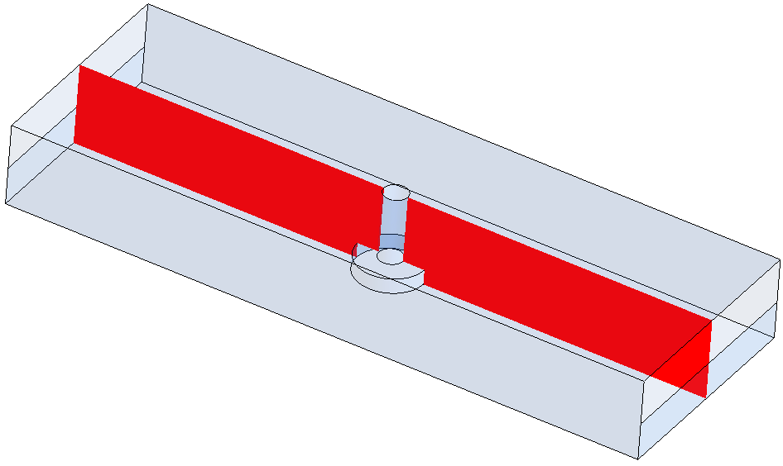
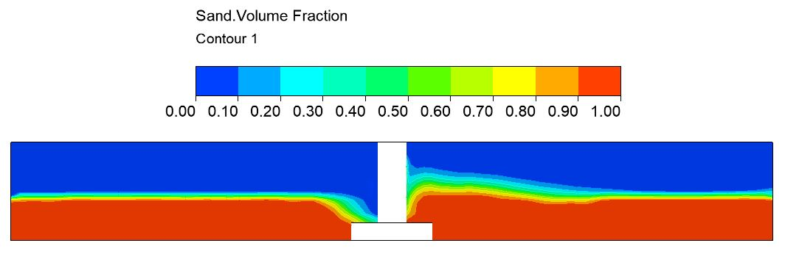
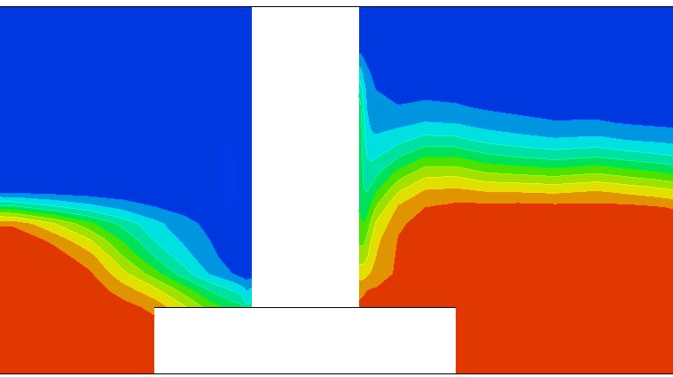
Sand Volume fraction plot at Plane 1
Plane 1

Slide 11
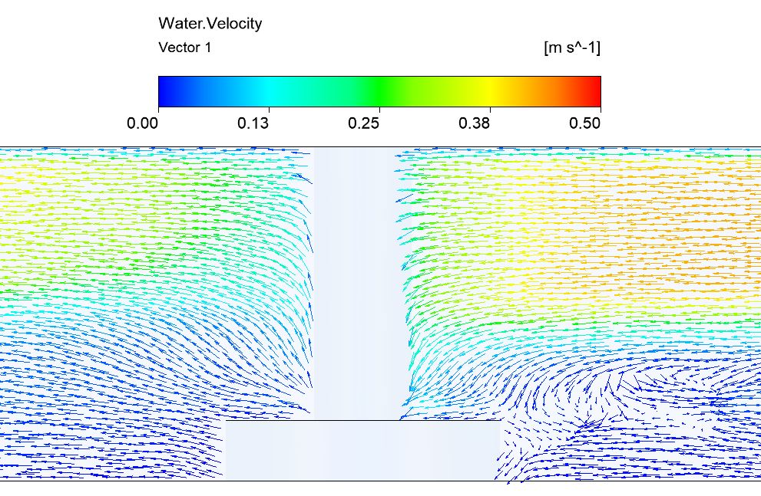
Velocity vectors
Plane 1

Slide 12
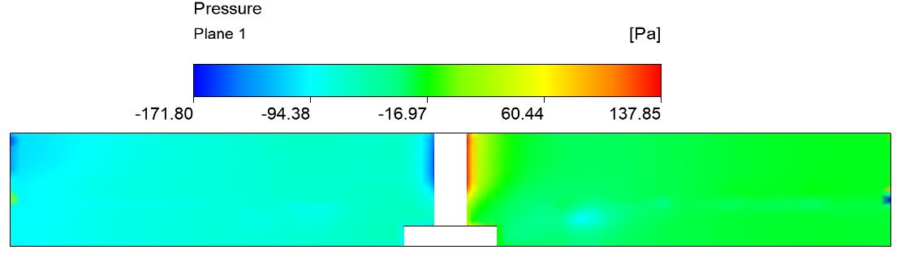
Pressure Plot
Plane 1

Slide 13
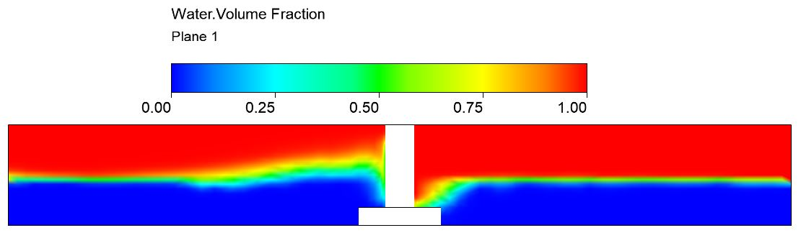
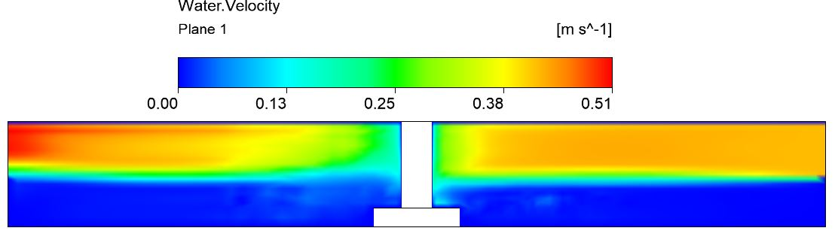
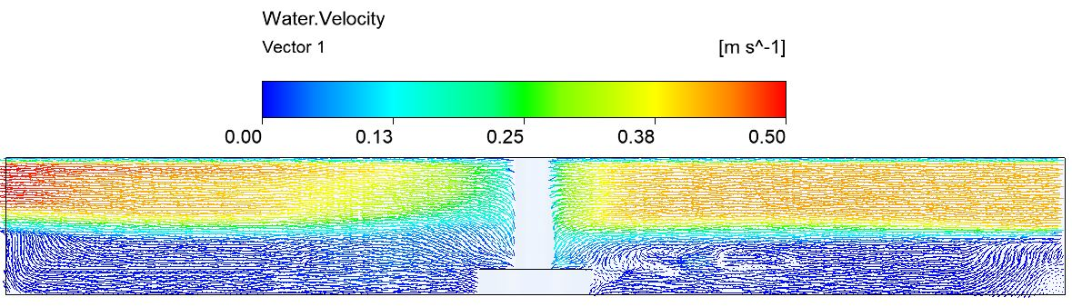
Plane 1

Slide 14
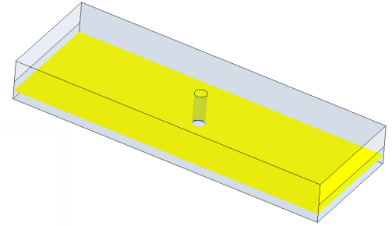
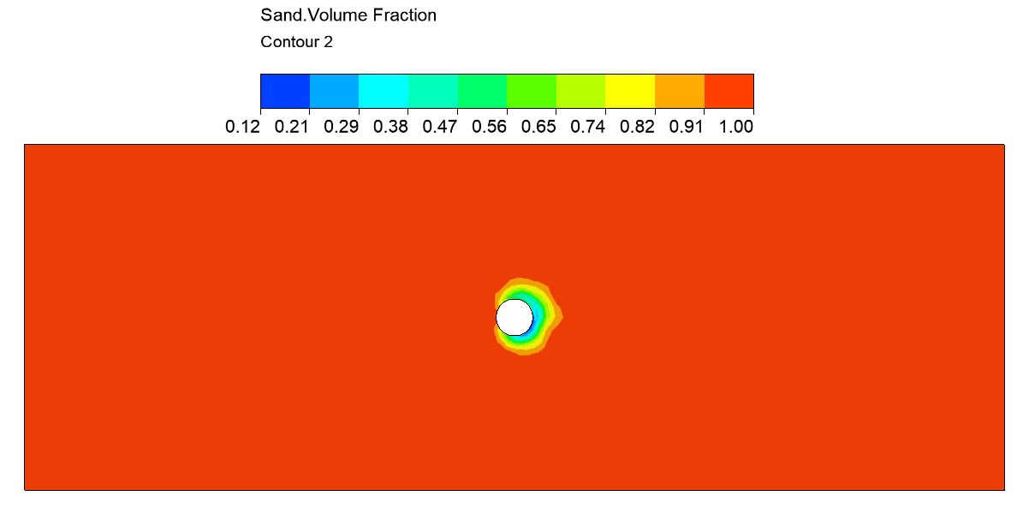
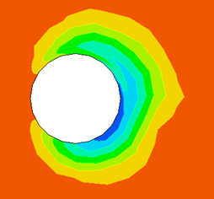
Sand Volume fraction plot at Plane 2
Plane 2

Slide 15
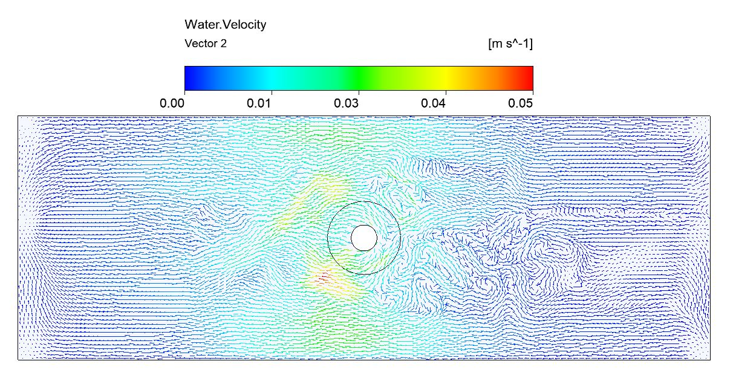
Velocity vectors at Plane 2
Plane 2

Slide 16
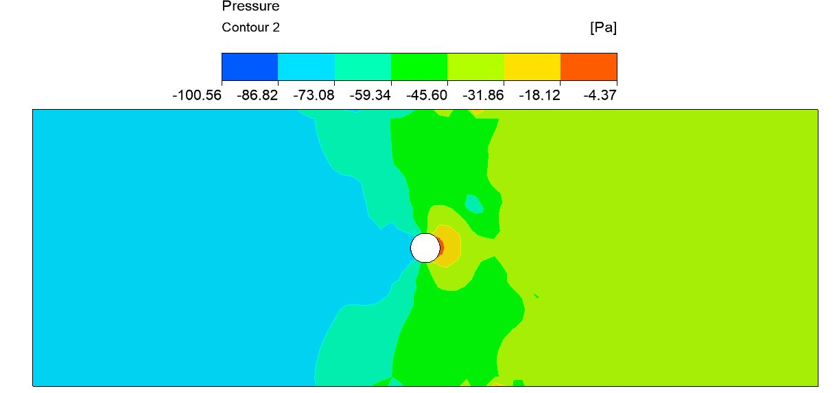
Pressure plot at Plane 2
Plane 2

Slide 17
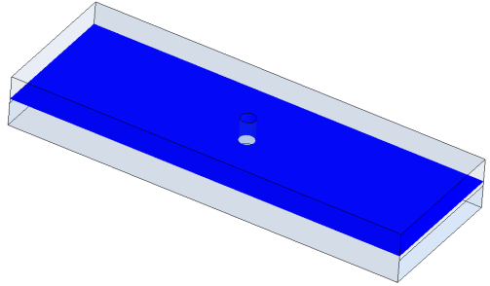
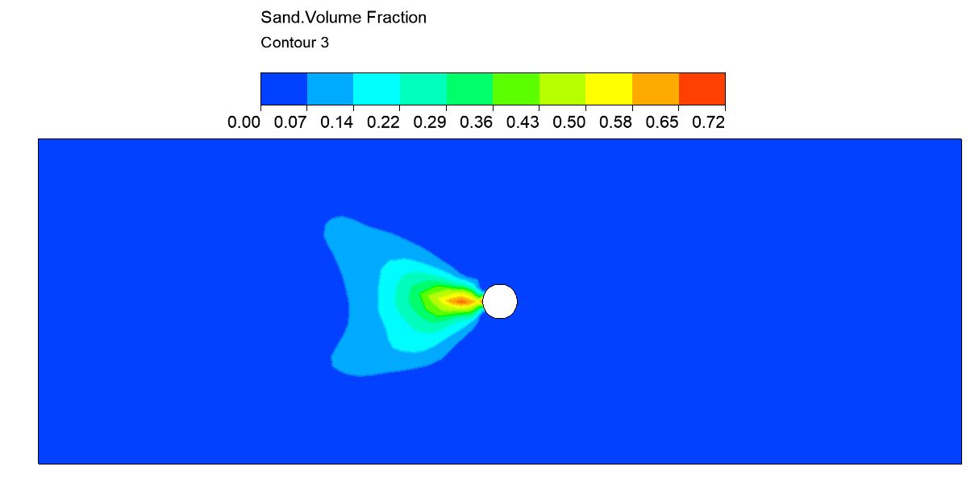
Sand Volume fraction plot at Plane 3
Plane 3

Slide 18
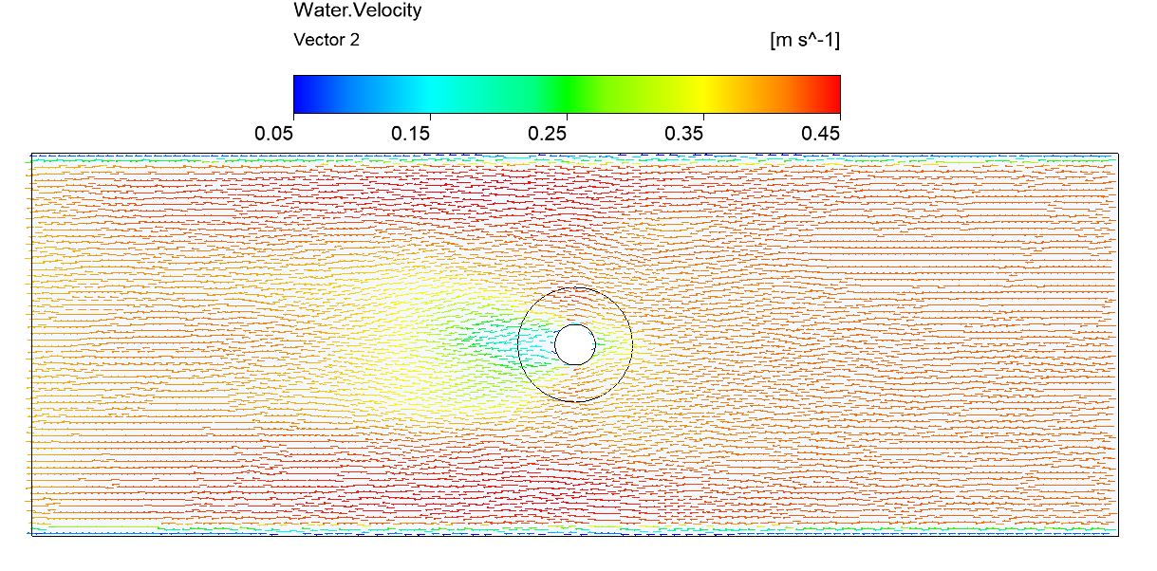
Velocity vectors at Plane 3
Plane 3

Slide 19
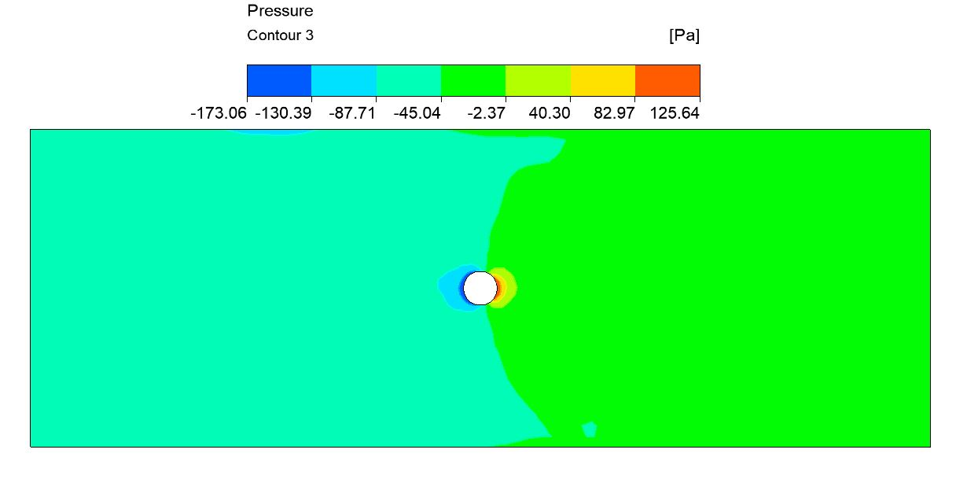
Pressure plot at Plane 3
Plane 3

Slide 20
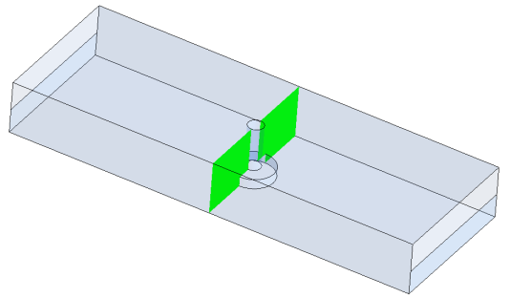
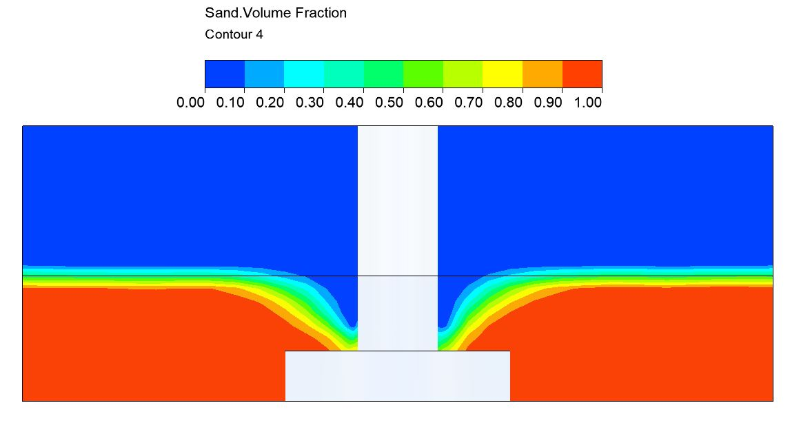
Sand Volume fraction plot at Plane 4
Plane 4

Slide 21
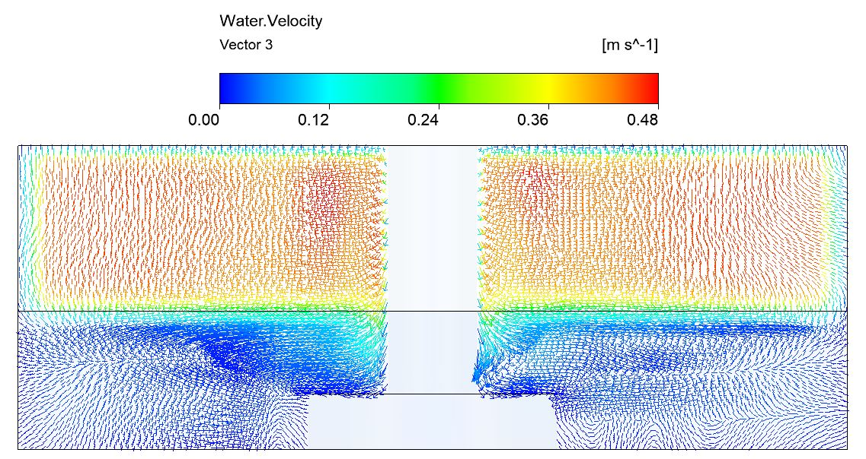
Velocity vectors at Plane 4
Plane 4

Slide 22
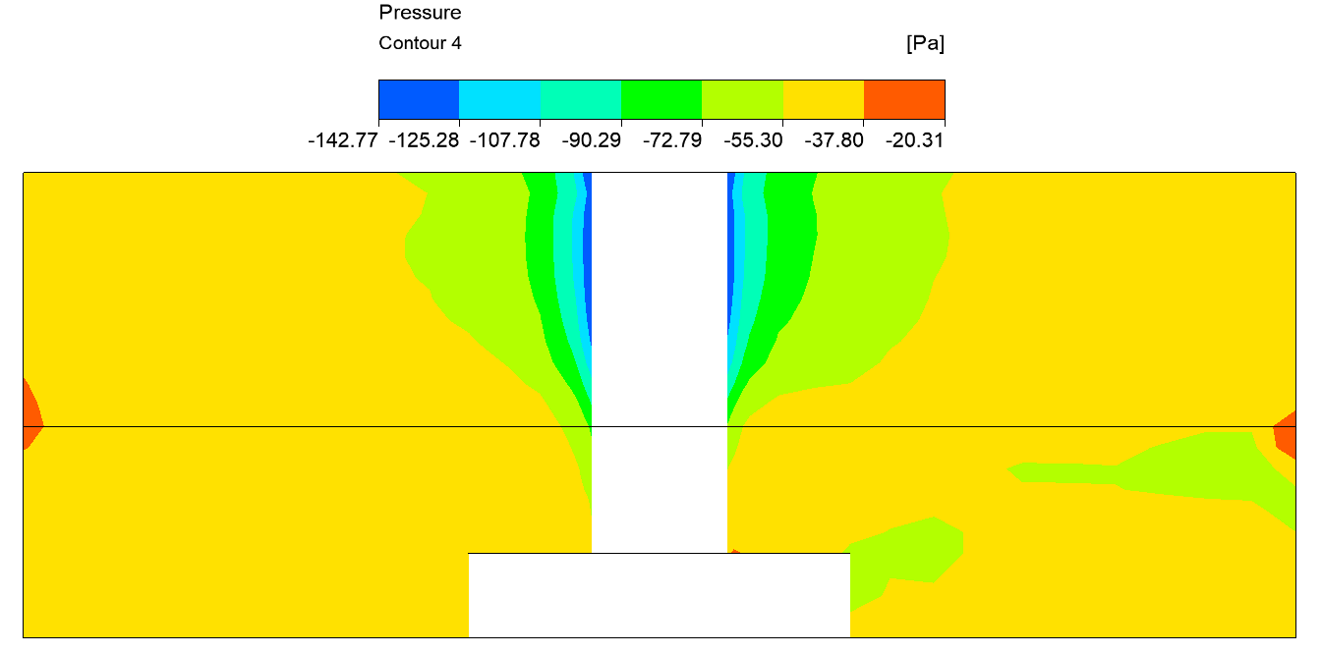
Pressure plot at Plane 4
Plane 4

Slide 23
Time Vs Scour depth plot
S/D
Time (s)
S/D is a dimensionless number where,
S: Y(m) at sand volume fraction 0.8
D: Diameter of pier (m)

Slide 24
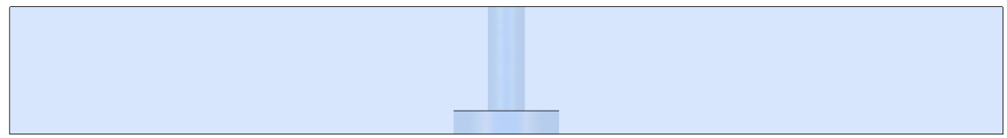
Distance x(m) Vs Sand Volume fraction at Y=-0.0595 and Z=0
Y= -0.0595, Z=0
Sand volume fraction
X(m)

Slide 25
Distance x(m) Vs Sand Volume fraction at Y=-0.0765 and Z=0
Y= -0.0765, Z=0

Slide 26
Distance x(m) Vs Sand Volume fraction at Y=-0.0935 and Z=0
Y = - 0.0935, Z=0
X(m)

Slide 27
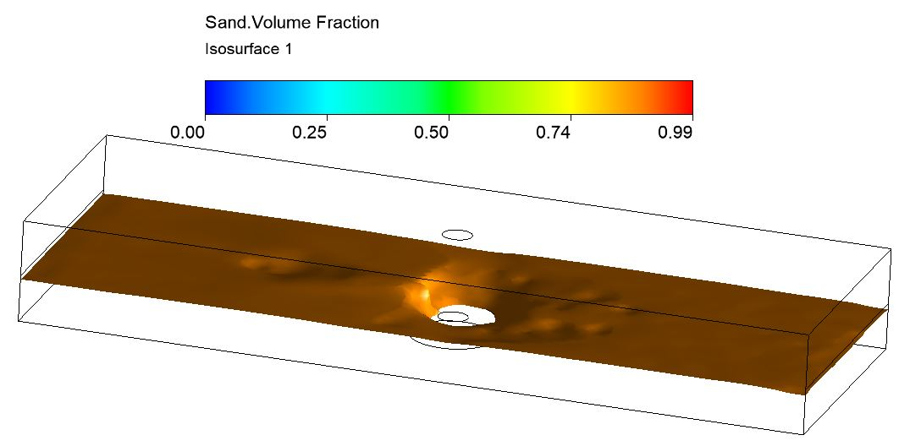
Iso-surface at Sand volume fraction = 0.8

Slide 28
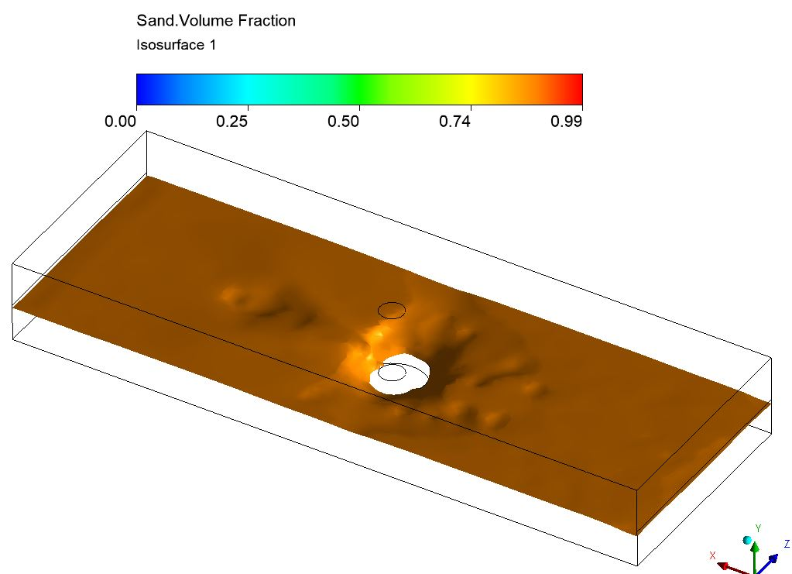
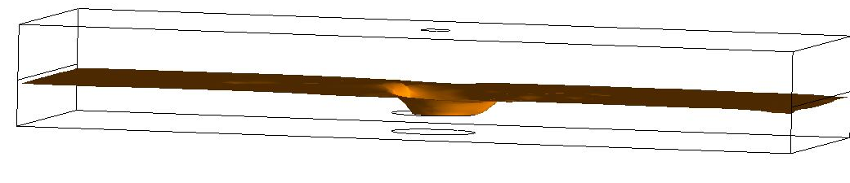
Iso-surface at Sand volume fraction = 0.8

Slide 29
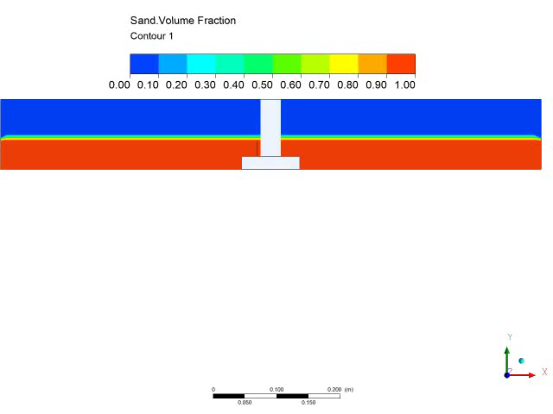
Time Vs Scour depth

Slide 30
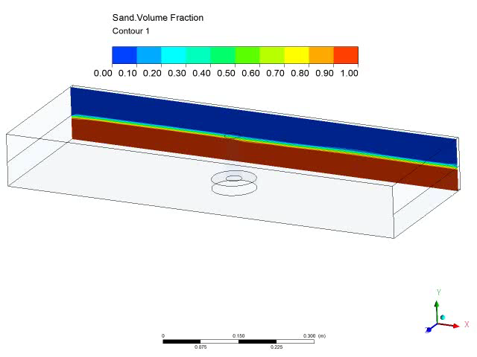
XY plane through the domain at time 1.224 sec

Slide 31
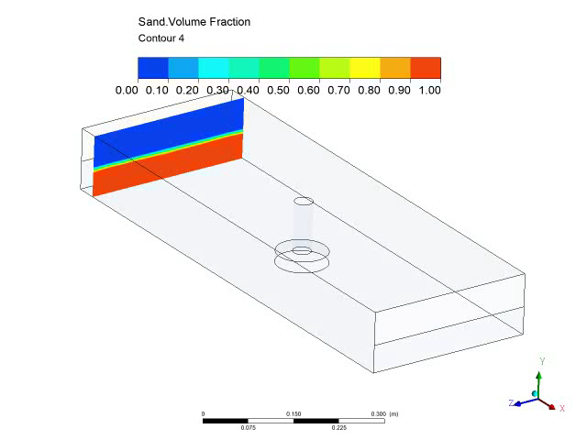
YZ plane through the domain at time 1.224 sec

Slide 32
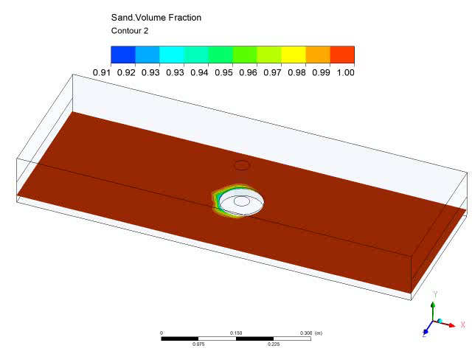
plane through the domain at time 1.224 sec

Slide 33
Observations and conclusion
The scour depth increases with time.
The scour spreads upstream, downstream,
left an right of the pillar.
Horse show effect is observed.

